Slide 1
Sentiment Analysis
Columbia University| 05 07 2020
Notes:
lue

Slide 2
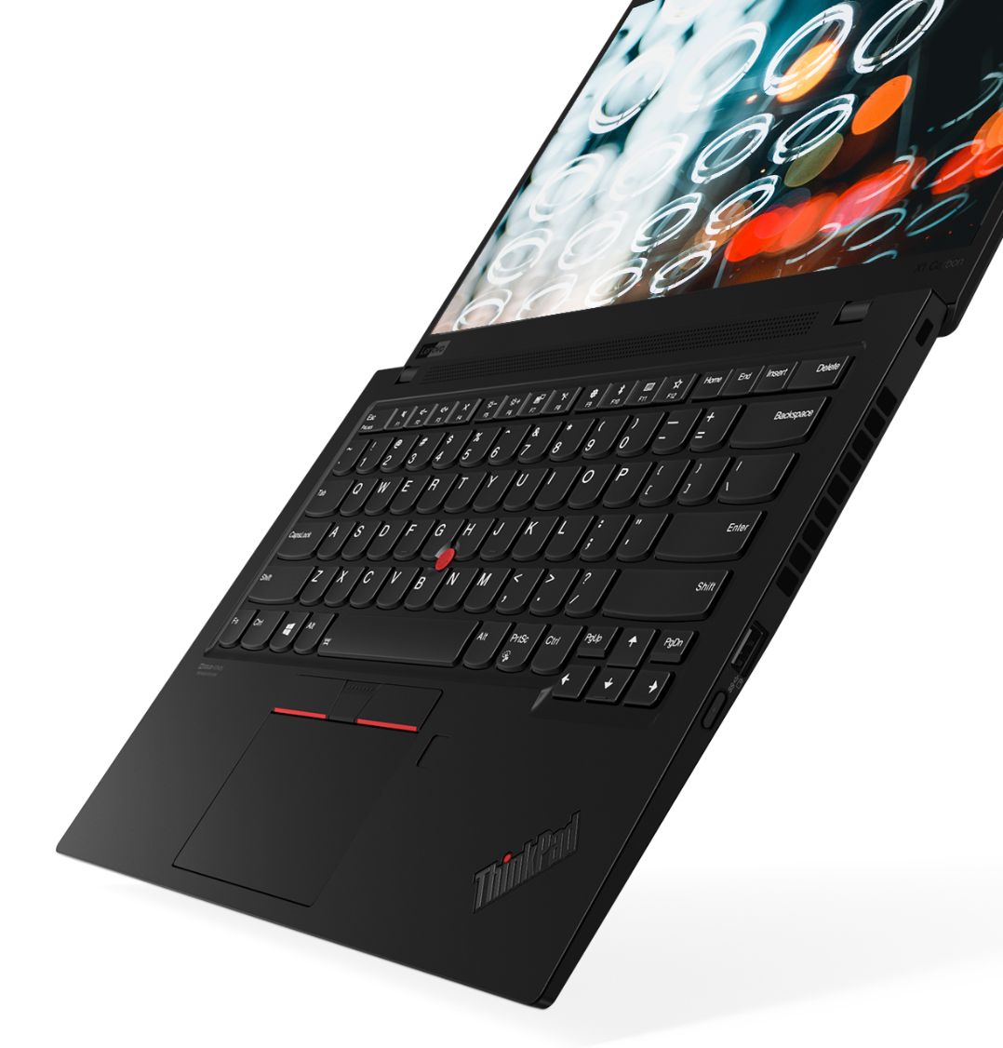
ThinkPad X1
Agenda
Project Objective and Scope
Sentiment Analysis (Glassdoor & Indeed)
Twitter Analysis
Questionnaire (Generational View)
Chinese Analysis
Advantages & Recommendations
Appendix
2020 Lenovo Internal. All rights reserved.

Slide 3
Project Objective and Scope
Project Objective: To help Lenovo understand the sentiment in the labor market towards it as an employer and the sentiment towards it’s peer group of organizations and competition
Business Context: Lenovo given its wide portfolio, is in markets with a very fast pace of change both with respect to technological advancements and intense competition it faces directly and indirectly. In the “War for Talent” with an imbalanced Demand Supply situation in the labor market, it becomes crucial to understand the sentiment of the talent market.
Expected Project Outcomes:
Sentiment Analysis on Lenovo and peer group from Glassdoor, Indeed and Twitter– Using Using nltk, Stanford CoreNLP and VaderSentiment
Generational Analysis
China Analysis
Student Survey
Competitor Companies: Samsung, Alibaba, Apple, Huawei, HP, Baidu, Microsoft, Dell, IBM

Slide 4
Sentiment Analysis
Companies Studied so far
Glassdoor: Lenovo: 340; Samsung: 440; Alibaba: 60; Apple: 4898; Huawei: 160; Hp: 740; Baidu: 40; Microsoft: 3759; Dell: 2568; IBM: 6330
Indeed: Lenovo: 1002; Samsung: 7243; Alibaba: 24; Apple: 8244; Huawei: 160; Hp: 12138; Baidu: 43; Microsoft: 6582; Dell: 10163; IBM: 28982
Twitter: Lenovo: 2000; Dell: 2000; Samsung: 2000; Alibaba: 2000; Apple: 2000; Huawei: 2000; Hp: 2000; Baidu: 2000; Microsoft: 2000; IBM: 2000

Slide 5
Sentiment Analysis
Steps followed in the analysis:
Used Stanford CoreNLP to perform part-of-speech tagging the reviews
Extracted phrases from those reviewers’ comments based on pos tags (descriptive words + noun.)
Manually evaluated meaningful keywords from those phrases based on five categories
Culture, Benefit, Work Environment, Career, Compensation
Packed all functions together - Call the main function to get an overall understand of what reviewers’ think of a specific aspect related to EVP of a company.
sentiment rating: -1 - 1, the higher the more positive sentiment (vader compound score)
phrases and reviews: related to the specific aspect

Slide 6
Sentiment Analysis - Lenovo
Career | Career | Position | Stability | Development | Growth | Train | Consult | Feedback
 | 0.39 | 0.13 | 0.01 | 0.27 | 0.52 | 0.40 | 0.30 | 0.23
Benefit | Health | Insurance | Stock | Time | Housing | Child | 401k | Holiday
 | 0.65 | 0.40 | -0.34 | 0.11 | / | 0.17 | 0.83 | 0.75
Compensation | Compensation | Pay | Salary | Money | Wage | Promotion | Bonus | Fair
 | 0.52 | 0.41 | 0.34 | -0.11 | -0.67 | 0.22 | 0.57 | 0.19
Culture | Culture | Manager | Collaboration | Support | Plan | Team | Trust | Responsibility
 | 0.39 | 0.35 | 0.70 | 0.74 | 0.14 | 0.34 | 0.42 | 0.69
Environment | Balance | Management | Global | Team | Training | Flexible | Health | Vacation
 | 0.30 | 0.15 | 0.37 | 0.34 | 0.43 | 0.78 | 0.65 | 0.54

Slide 7
Sentiment Analysis - Apple
Career | Career | Position | Stability | Development | Growth | Train | Consult | Feedback
 | 0.26 | 0.13 | 0.52 | 0.40 | 0.41 | 0.42 | 0.12 | 0.38
Benefit | Health | Insurance | Stock | Time | Housing | Child | 401k | Holiday
 | 0.63 | 0.63 | 0.69 | 0.16 | 0.12 | 0.15 | 0.76 | 0.24
Compensation | Compensation | Pay | Salary | Money | Wage | Promotion | Bonus | Fair
 | 0.52 | 0.49 | 0.55 | 0.34 | 0.33 | 0.17 | 0.61 | 0.30
Culture | Culture | Manager | Collaboration | Support | Plan | Team | Trust | Responsibility
 | 0.53 | 0.15 | 0.19 | 0.57 | 0.40 | 0.45 | 0.41 | 0.20
Environment | Balance | Management | Global | Team | Training | Flexible | Health | Vacation
 | 0.04 | 0.12 | 0.58 | 0.45 | 0.43 | 0.62 | 0.63 | 0.38

Slide 8
Sentiment Analysis - Dell
Career | Career | Position | Stability | Development | Growth | Train | Consult | Feedback
 | 0.37 | 0.24 | 0.26 | 0.41 | 0.49 | 0.43 | 0.10 | 0.28
Benefit | Health | Insurance | Stock | Time | Housing | Child | 401k | Holiday
 | 0.52 | 0.42 | 0.13 | 0.19 | 0.70 | 0.52 | 0.72 | 0.54
Compensation | Compensation | Pay | Salary | Money | Wage | Promotion | Bonus | Fair
 | 0.35 | 0.38 | 0.45 | 0.28 | 0.66 | 0.13 | 0.60 | 0.49
Culture | Culture | Manager | Collaboration | Support | Plan | Team | Trust | Responsibility
 | 0.55 | 0.29 | 0.38 | 0.62 | 0.14 | 0.39 | 0.46 | 0.45
Environment | balance | management | global | team | training | flexible | health | vacation
 | 0.64 | 0.12 | 0.48 | 0.39 | 0.48 | 0.73 | 0.52 | 0.51

Slide 9
Sentiment Analysis - Hp
Career | Career | Position | Stability | Development | Growth | Train | Consult | Feedback
 | 0.36 | 0.16 | 0.06 | 0.49 | 0.42 | 0.24 | 0.86 | 0.37
Benefit | Health | Insurance | Stock | Time | Housing | Child | 401k | Holiday
 | 0.58 | 0.21 | -0.07 | 0.13 | -0.17 | -0.18 | 0.32 | 0.39
Compensation | Compensation | Pay | Salary | Money | Wage | Promotion | Bonus | Fair
 | 0.28 | 0.19 | 0.41 | 0.53 | 0.41 | -0.04 | 0.38 | 0.43
Culture | Culture | Manager | Collaboration | Support | Plan | Team | Trust | Responsibility
 | 0.63 | 0.33 | 0.39 | 0.59 | -0.02 | 0.47 | 0.56 | 0.33
Environment | Balance | Management | Global | Team | Training | Flexible | Health | Vacation
 | 0.58 | 0.25 | 0.44 | 0.47 | 0.26 | 0.67 | 0.58 | 0.22

Slide 10
Sentiment Analysis - IBM
Career | Career | Position | Stability | Development | Growth | Train | Consult | Feedback
 | 0.35 | 0.22 | 0.15 | 0.33 | 0.41 | 0.43 | 0.25 | 0.21
Benefit | Health | Insurance | Stock | Time | Housing | Child | 401k | Holiday
 | 0.46 | 0.33 | 0.24 | 0.12 | 0.35 | 0.25 | 0.48 | 0.55
Compensation | Compensation | Pay | Salary | Money | Wage | Promotion | Bonus | Fair
 | 0.19 | -0.14 | -0.23 | 0.96 | 0.05 | 0.32 | -0.02 | -
Culture | Culture | Manager | Collaboration | Support | Plan | Team | Trust | Responsibility
 | 0.38 | 0.16 | 0.40 | 0.54 | 0.19 | 0.35 | 0.50 | 0.28
Environment | Balance | Management | Global | Team | Training | Flexible | Health | Vacation
 | 0.54 | 0.05 | 0.54 | 0.35 | 0.46 | 0.68 | 0.46 | 0.49

Slide 11
Sentiment Analysis - Microsoft
Career | Career | Position | Stability | Development | Growth | Train | Consult | Feedback
 | 0.36 | 0.28 | 0.41 | 0.35 | 0.60 | 0.32 | 0.12 | 0.10
Benefit | Health | Insurance | Stock | Time | Housing | Child | 401k | Holiday
 | 0.63 | 0.78 | 0.58 | 0.13 | 0.25 | 0.59 | 0.79 | 0.34
Compensation | Compensation | Pay | Salary | Money | Wage | Promotion | Bonus | Fair
 | 0.49 | 0.50 | 0.49 | 0.28 | 0.28 | 0.08 | 0.61 | 0.35
Culture | Culture | Manager | Collaboration | Support | Plan | Team | Trust | Responsibility
 | 0.48 | 0.14 | 0.31 | 0.62 | 0.20 | 0.28 | 0.48 | 0.53
Environment | alance | Management | Global | Team | Training | Flexible | Health | Vacation
 | 0.60 | 0.08 | 0.68 | 0.28 | 0.38 | 0.73 | 0.63 | 0.61

Slide 12
Sentiment Analysis - Samsung
Career | Career | Position | Stability | Development | Growth | Train | Consult | Feedback
 | 0.29 | 0.13 | 0.96 | 0.56 | 0.11 | 0.42 | 0.00 | 0.60
Benefit | Health | Insurance | Stock | Time | Housing | Child | 401k | Holiday
 | 0.63 | 0.79 | -0.61 | 0.15 | 0.21 | -0.15 | 0.90 | 0.30
Compensation | Compensation | Pay | Salary | Money | Wage | Promotion | Bonus | Fair
 | 0.70 | 0.60 | 0.53 | -0.05 | 0.97 | 0.41 | 0.86 | 0.16
Culture | Culture | Manager | Collaboration | Support | Plan | Team | Trust | Responsibility
 | 0.22 | -0.08 | 0.96 | 0.37 | 0.64 | 0.43 | -0.13 | 0.74
Environment | Balance | Management | Global | Team | Training | Flexible | Health | Vacation
 | -0.15 | -0.14 | 0.71 | 0.43 | 0.36 | 0.84 | 0.63 | 0.56

Slide 13
Twitter Analysis - Steps
Companies studies: Lenovo and Dell
We, together with Kanika, used Twitter API in R to get reviews for the following keywords:
Lenovo + leadership
Lenovo + diversity
Lenovo + workforce
Lenovo + university
Lenovo + culture
Lenovo + employees
Lenovo + coronavirus / covid
#wearelenovo
Then, we filtered the text manually to get the meaningful reviews, because most of the tweets are product comments, which are given by customers, not closely related to the EVP refining. Using those text we get, search for the original tweets on Twitter.
Calculated two sentiment scores for all tweets related to Lenovo and the useful employee reviews.

Slide 14
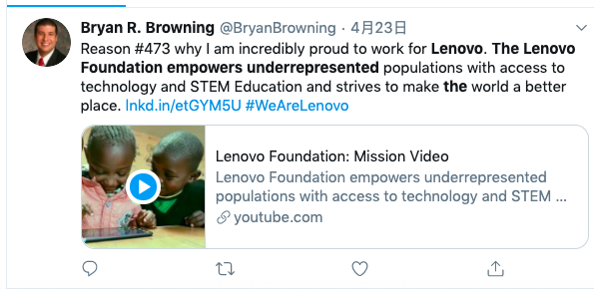
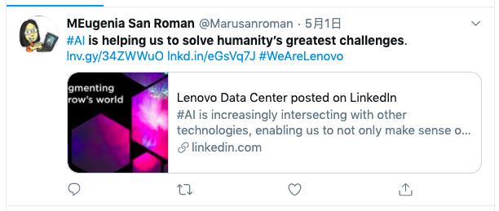
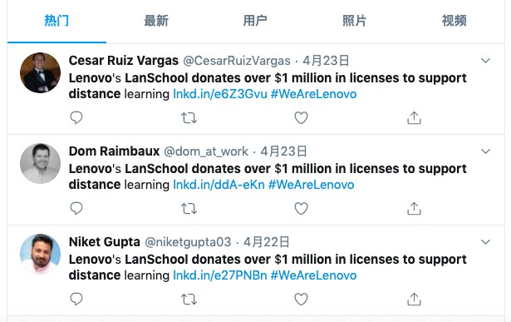
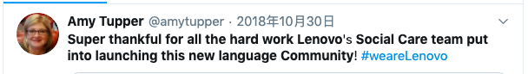
Twitter Analysis - Findings
Lenovo is with great social responsibility and cares humanity. This makes the employees feel proud of the company.

Slide 15
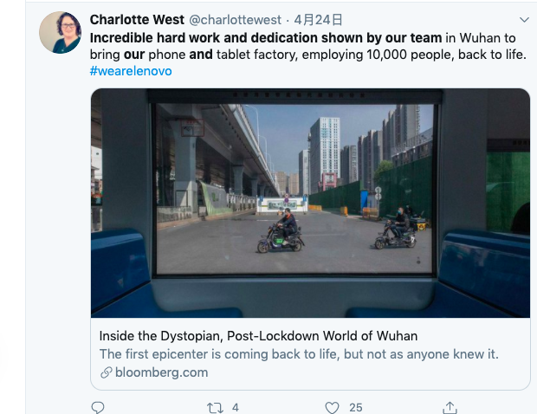
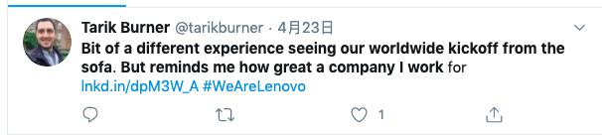
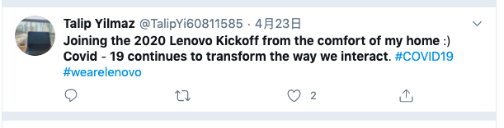
Twitter Analysis - Findings
Lenovo is with great social responsibility and cares humanity. This makes the employees feel proud of the company.

Slide 16
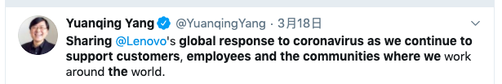
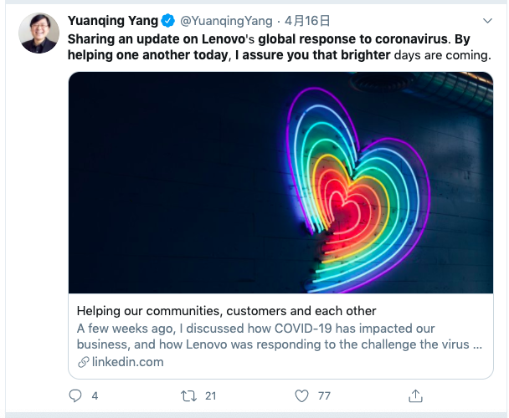
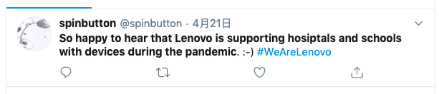
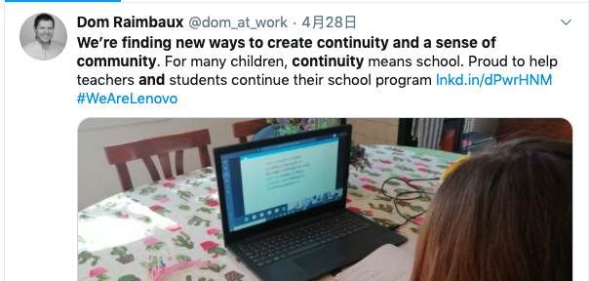
Twitter Analysis - Findings
Lenovo is with great social responsibility and cares humanity. This makes the employees feel proud of the company.

Slide 17
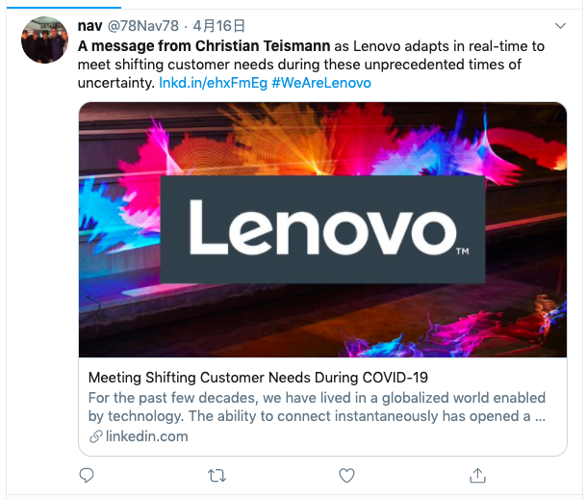
Twitter Analysis - Findings
Lenovo is with great social responsibility and cares humanity. This makes the employees feel proud of the company.

Slide 18
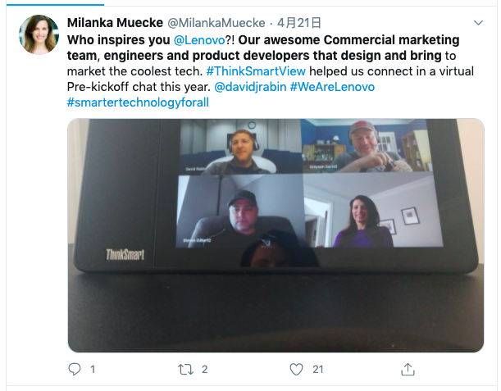
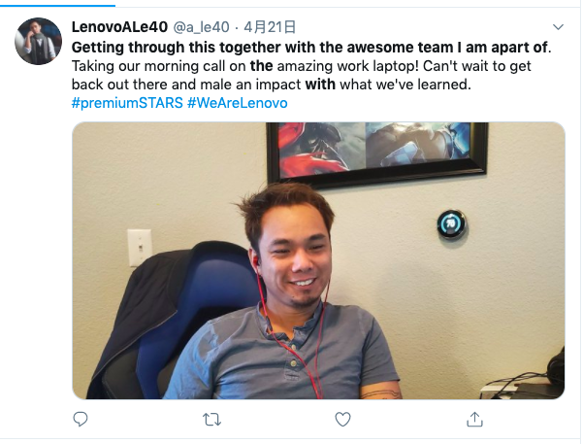
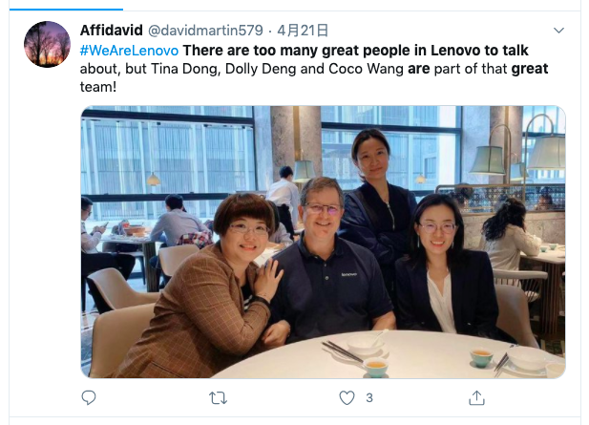

Twitter Analysis - Findings
The teams are great in Lenovo.

Slide 19
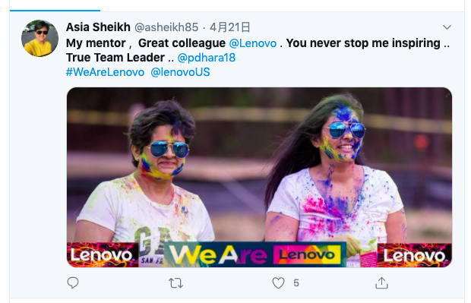
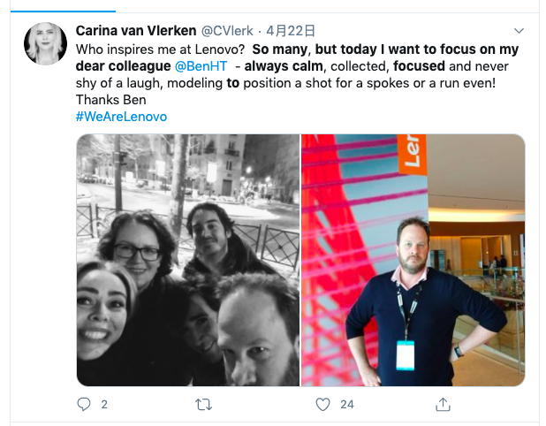
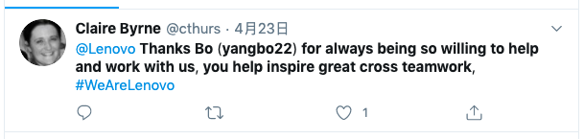
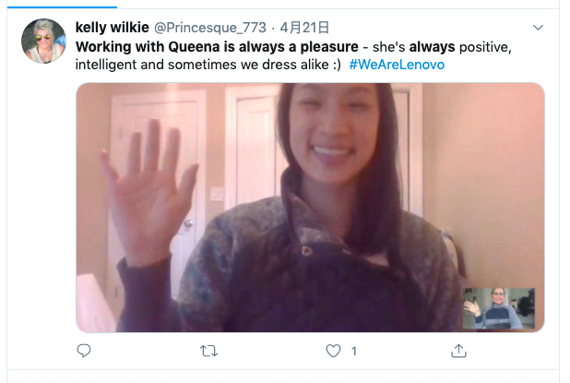
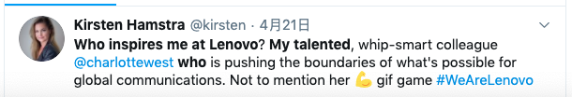
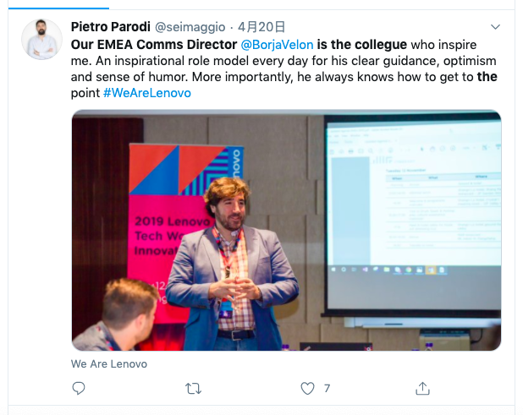
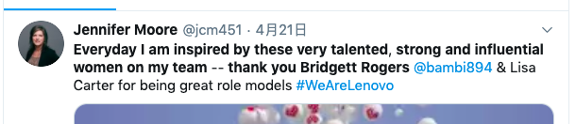
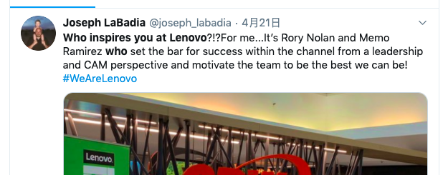
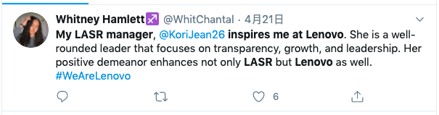
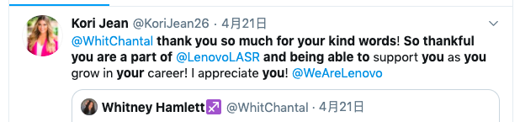
Twitter Analysis - Findings
The colleagues & leaders are great in Lenovo.

Slide 20
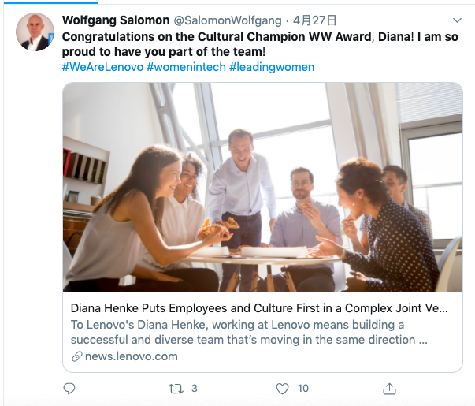

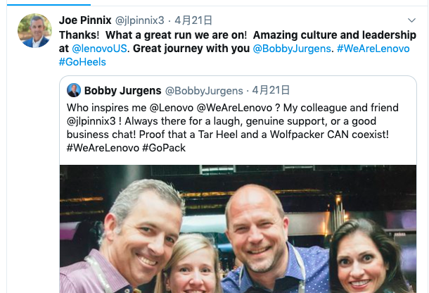
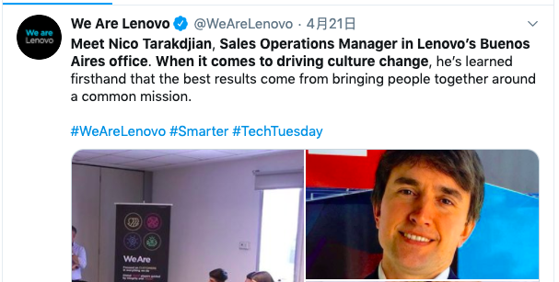
Twitter Analysis - Findings
Lenovo is open to diverse culture.

Slide 21
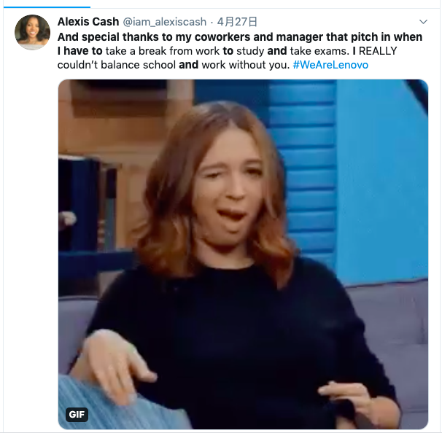
Twitter Analysis - Findings
Lenovo shows great concern for the work-life balance.

Slide 22
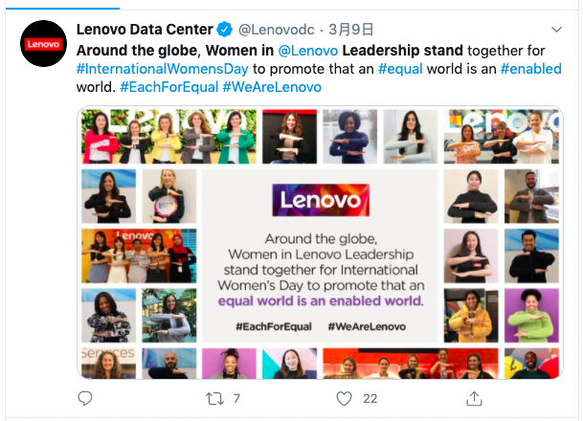

Twitter Analysis - Findings
Lenovo cares about gender equality.

Slide 23
Twitter Analysis - Scores
Here are the results we find from the tweets.
Company name | type of tweets | score
Dell | useful reviews | 2.24
 | all tweets | 0.4195
Lenovo | useful reviews | 1.625
 | all tweets | 0.3145

Slide 24
Survey Questionnaire
Key questions in the questionnaire
Background Information
Specific preferences of the Company
Compensation, Benefit, Environment, Career, Culture
Short Answer
Questionnaire handout
Amazon Mechanical Turk (181)
Free response (62 Part 1 + 63 Part 2)

Slide 25
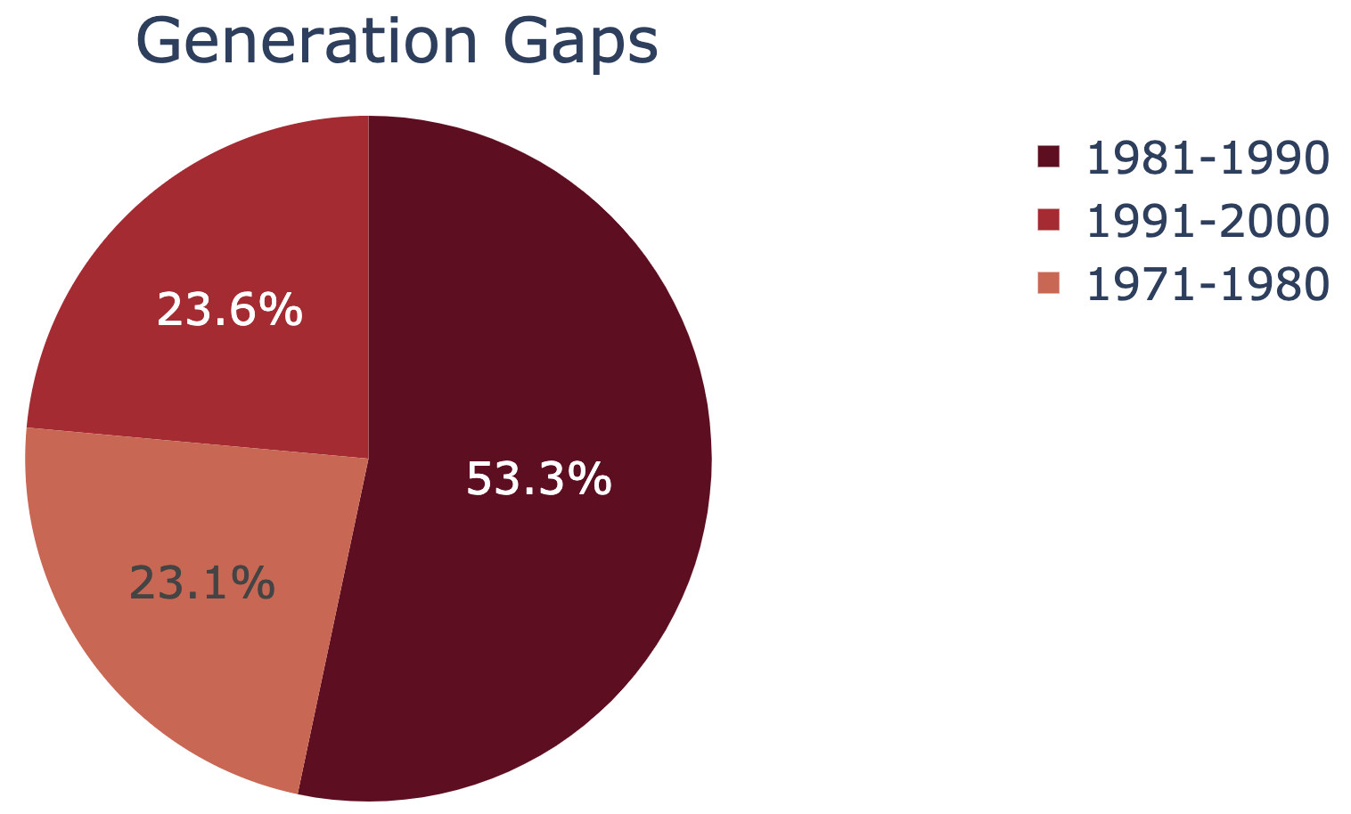
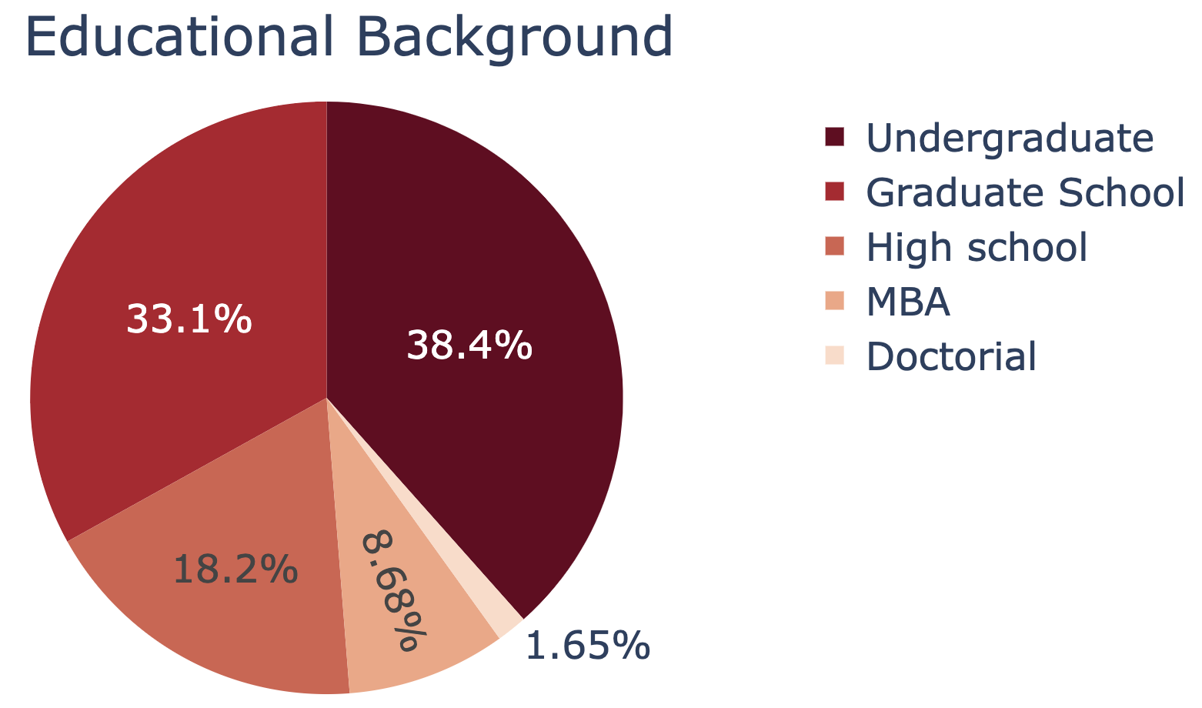
Questionnaire results
Need: Glassdoor, Indeed and other resources doesn’t disclose the age of employee reviewers
We’ve collected 181 responses from Amazon Turk, 62 responses from Survey Monkey Part 1 ( Benefit, Compensation, Career) and 63 responses from Survey Monkey Part 2 ( Environment, Culture).
Overview of those respondents:

Slide 26
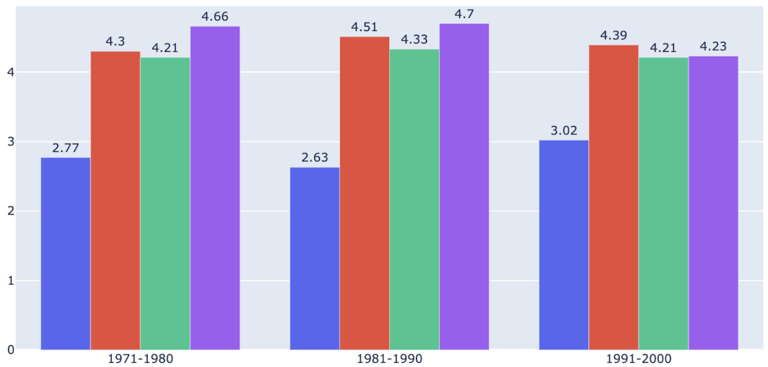

Findings
Compensation:
Salary Growth
Promotion
Bonus Plan
Fairness
For all generation groups, they care more about promotion, bonus plan, and fairness (all of which above 4) instead of salary growth (around 2 to 3).

Slide 27
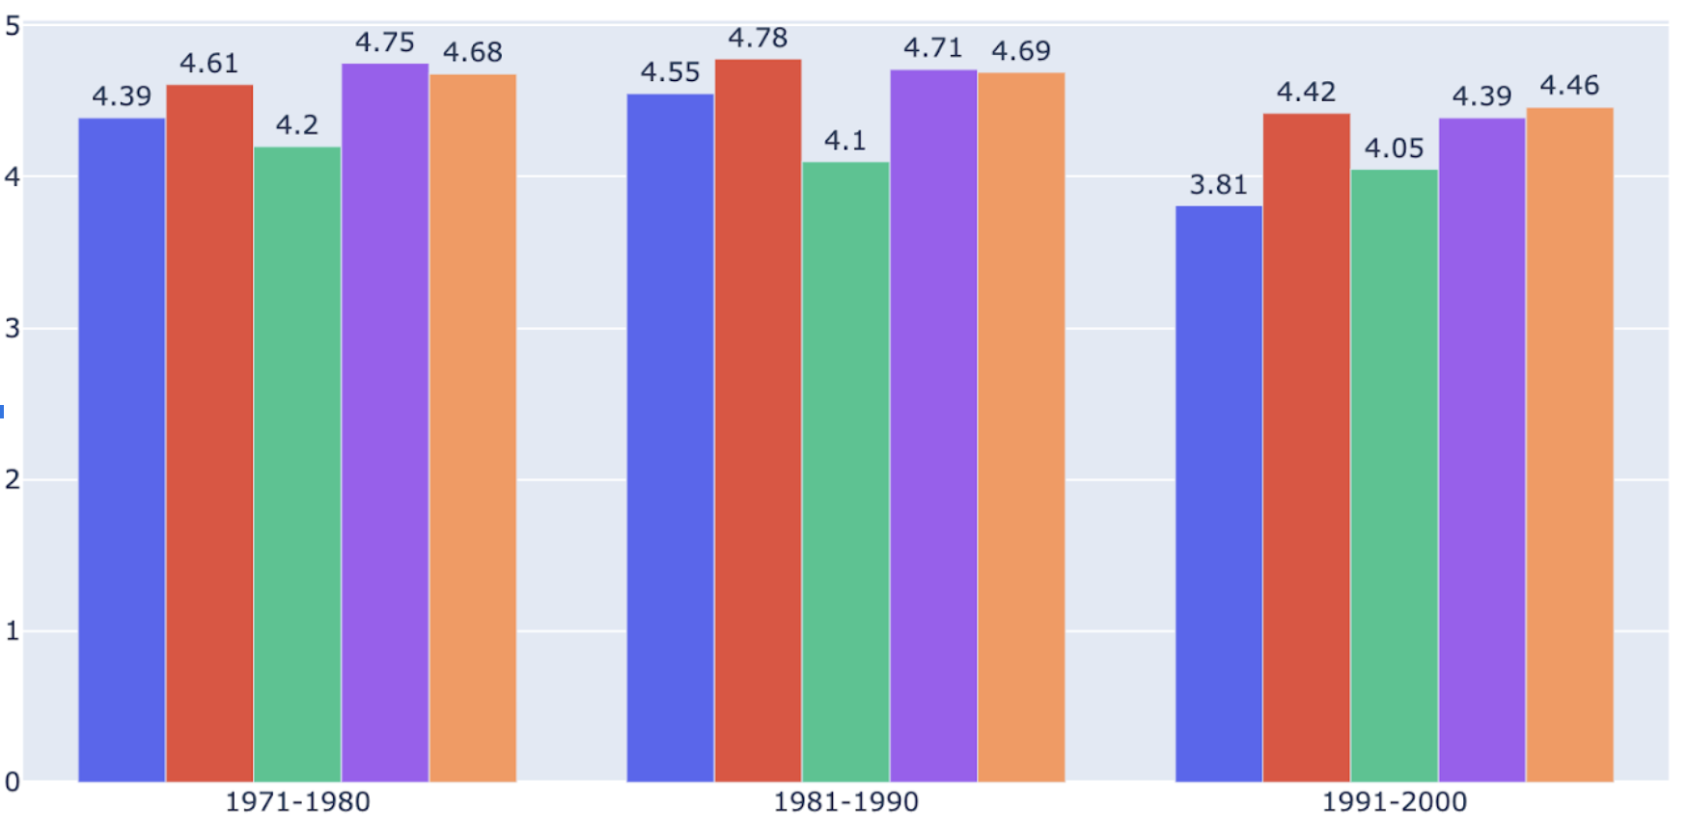

Findings
Benefit:
Paid Overtime
Insurance
Flexitime
Paid Sick Leave
Yearly Holiday
Because of more serious competitions and peer pressures in job market, young generations (1991 - 2000) has marginal demand on different benefits from their company.

Slide 28
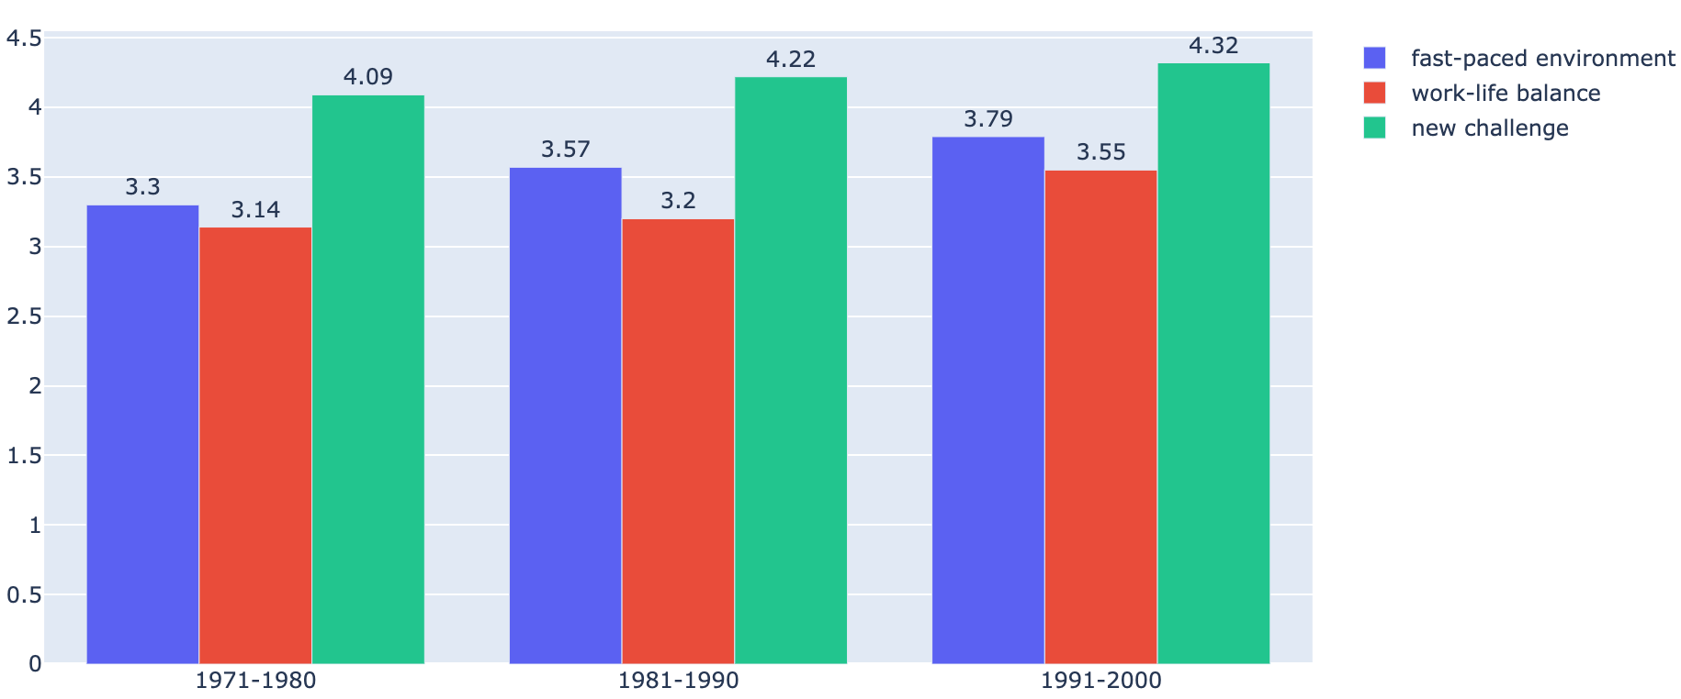
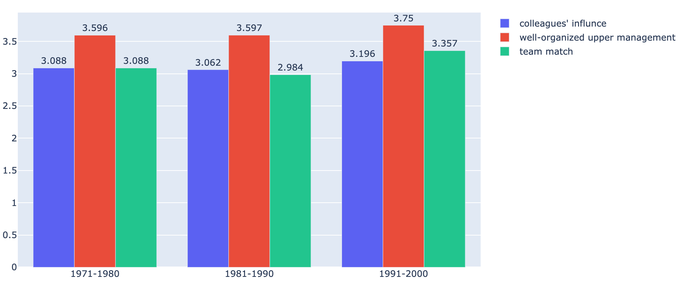
Findings
Environment:
For young generations (1991 -2000), They are more satisfied with fast-paced environment and new challenge.
They also care more about their companies’ brand than those older generations

Slide 29
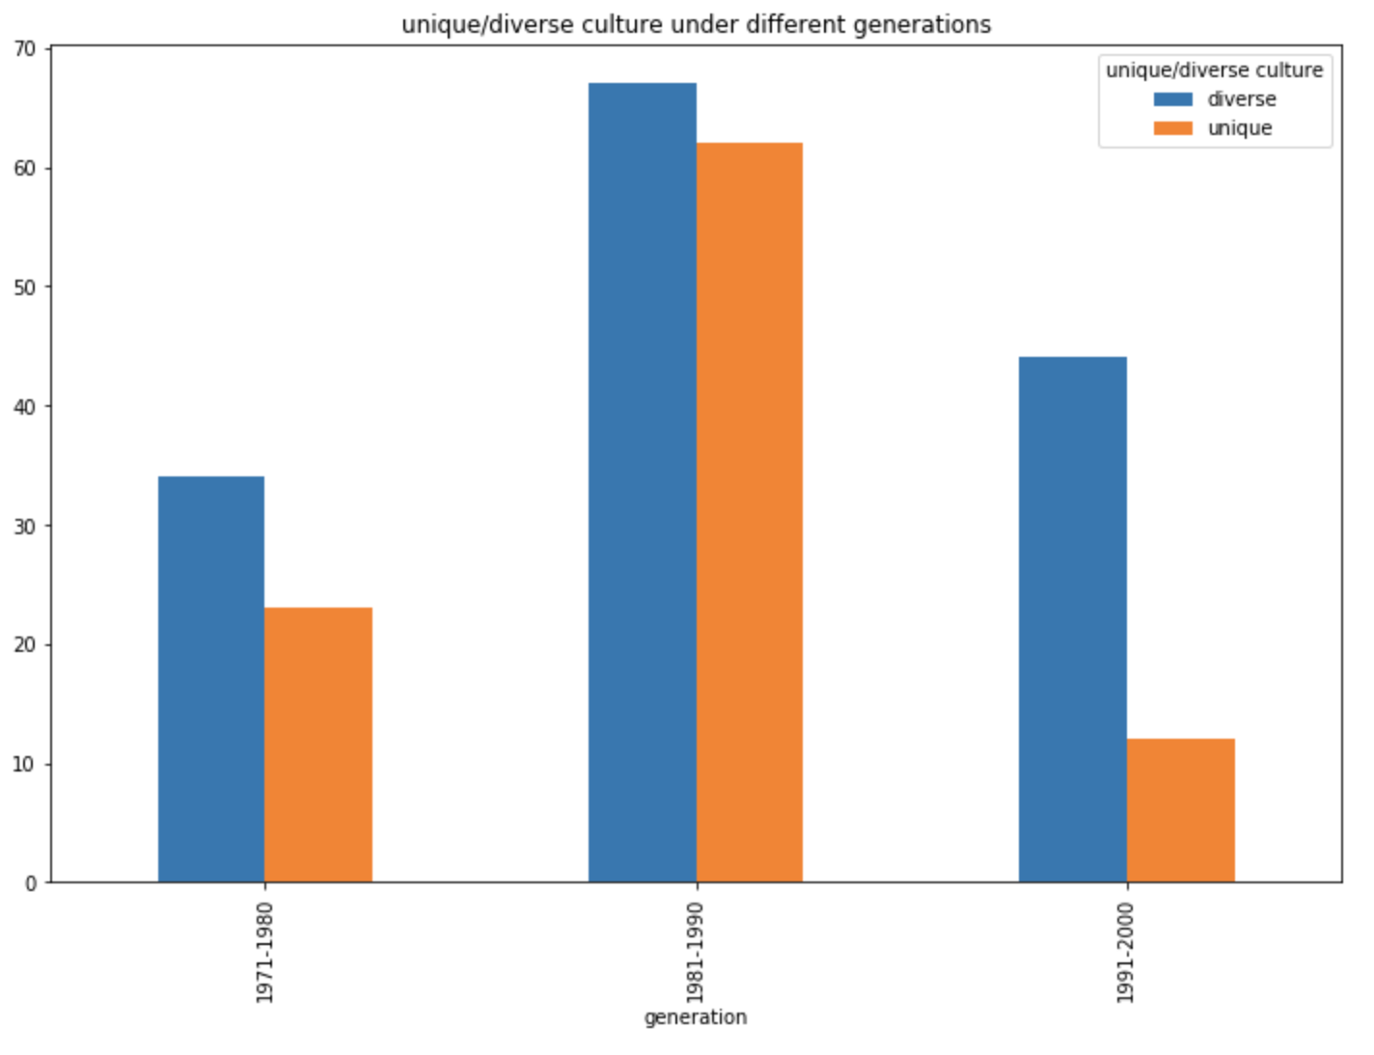
Findings
Culture:
67
62
Here, we can see for younger generations (1991 to 2000), there are a larger proportion of them want a diverse culture in their companies instead of a unique culture.
44
34
23
12

Slide 30
Chinese Companies Analysis
Sources used
kanzhun.com
jobui
qp1001
zhihu
Note
Not many reviews for American companies
So we focused on Chinese based companies for comparison

Slide 31
Chinese Companies Analysis
overall results for Kanzhun.com
overall results for qp1001
overall results for jobui
Company | Lenovo | Alibaba | Baidu | Huawei
Rating | 4.0 | 4.4 | 4.3 | 4.1
Reviews | 1427 | 2351 | 16416 | 6655
Company | Lenovo | Alibaba | Baidu | Huawei
Rating | 2.0 | 4.0 | 3.0 | 3.0
Reviews | 75 | 98 | 138 | 194
Company | Lenovo | Alibaba | Baidu | Huawei
Good Rating Rate | 71% | 78% | 70% | 71%
Reviews | 29 | 260 | 36 | 588

Slide 32
Lenovo
Pros | Cons
Give enough freedom to employees | Hard to get promotion (need relationships)
Global company | Only suitable for those old employees instead of young generation
Appropriate work time | Not suitable for new graduates
big brand in china | Bad management of internships
Good company culture | Don’t have too much work to do
Good work-life balance | bureaucratism
Good work environment and almost no extra work | Suitable for someone who is married
High salary | Technology is relatively traditional, lack of creativity
World-class company | Not suitable for technician
Take care of employee’s health | No creativity
Humanism

Slide 33
Alibaba
Pros | Cons
Top tech companies in China (Ali cloud service) | Too much extra work
Suitable for hardworking employees | Suitable for young generation
Big brand | Health in exchange of money
Suitable to improve yourself | Human Resource department is not very good
Good company for technical position | Excessive Work pressure
Good salary
Promotion is based on personal performance
Good place to do some research
Many highly skilled programmer
Frontier research and frontier technology

Slide 34
Baidu
Pros | Cons
Good engineer culture | Too much extra work
Eager to develop young generations; Good mentorships to help those new employees | Hard to get promotion
Very suitable for young generation | Salary is not very competitive
Big company with advanced technologies | Used to be a top tech company, but outdated
Good culture | Very bad research lab
Very suitable for new graduates | bureaucratism
Good management
Suitable for future development
Don’t have too much meetings

Slide 35
Huawei
Pros | Cons
Big brand in China | Not suitable for internship
Good work environment and high salary | extra work for a long time
Maybe the greatest Chinese Tech company | 60% of weekdays need to work until 10:30pm
Culture of hardworking | Interview is too easy
Suitable for young generation | Not very suitable to stay for a long time
Good management | Hiring process is bad, hiring some under qualified employees
Work environment is easy to adopt, similar to research lab | Technology is not diversified

Slide 36

Advantage over its peer group
“联想是一个没有天花板的舞台”
Lenovo is a stage without a ceiling
Summary

Slide 37



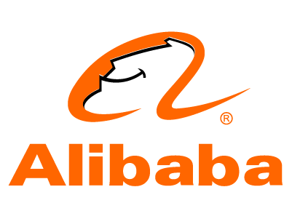





Advantage over its peer group
Better
collaboration
Collaboration,
Support,
Holiday Benefit
Better 401K,
Collaboration
and Holiday
Overall culture, Better global brand name
Work-Life balance,
Better Internship
Better support for career development
Lenovo is more stable,
Better culture and management
Humanism, Caring for employee,Work-Life balance
Better Bonus;
Collaboration and support

Slide 38
Recommendations from the analysis
Promotion opportunity and plans
Company Culture: younger generations are more able to embrace challenge and like more diverse culture
Creativity is a key for Tech companies

Slide 40
Appendix
Code (Python)
web scraping
nlp -tag & phrase
filter keywords
pack into the main function
score comparison(Twitter)
Data
Reviews(Glassdoor)
Phrases(Glassdoor)
Reviews(Twitter)
Reviews(Indeed)
Questionnaire (English Version)

Slide 41
More Charts

